Slide 1
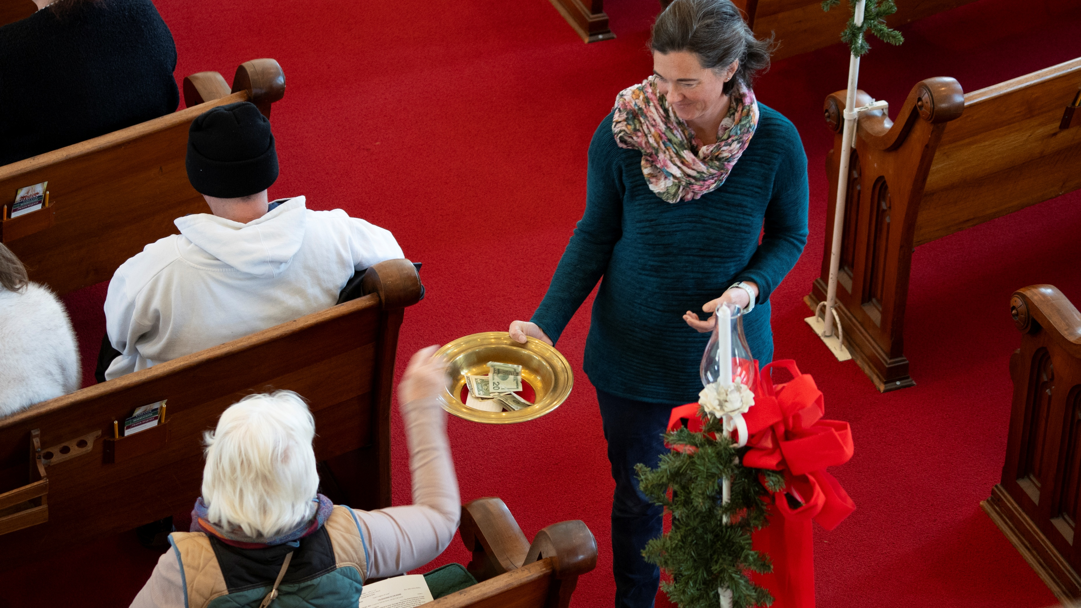
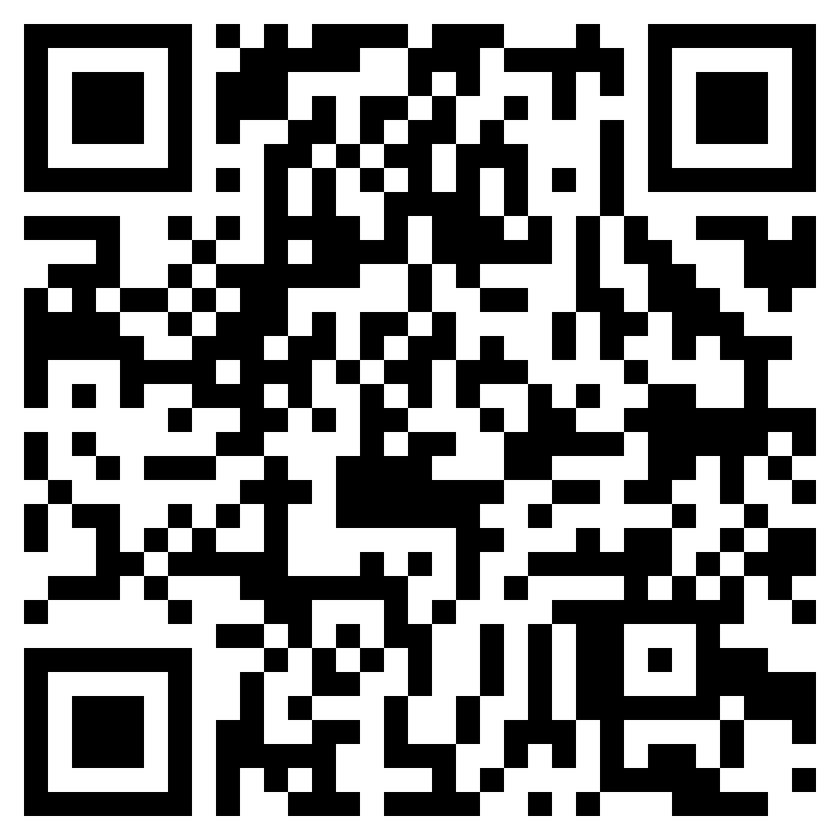

^{Make your year-end}
^{gift count}
The Presbyterian Foundation is here to help you with your year-end giving. Gifts need to be postmarked by December 31, 2025 to count as tax deductions for this year.
Go to presbyterianfoundation.org/year-end-giving for more information.

